Slide 1
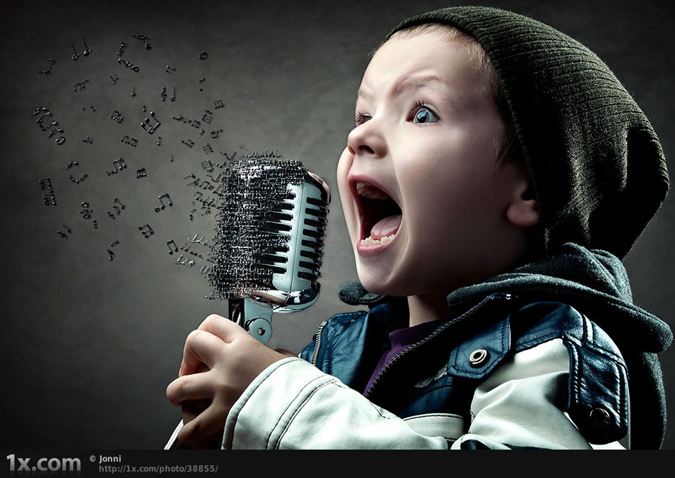
Poetry and Songs
Poems and Songs to use in teaching English to Malaysian children.

Slide 2
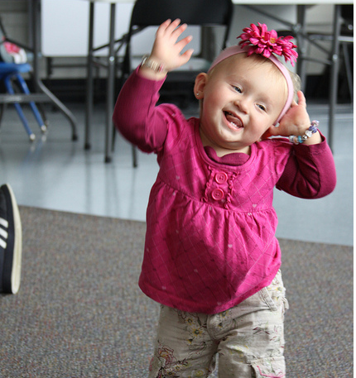
Why??
1. Fun – motivation, improves learning

Slide 3
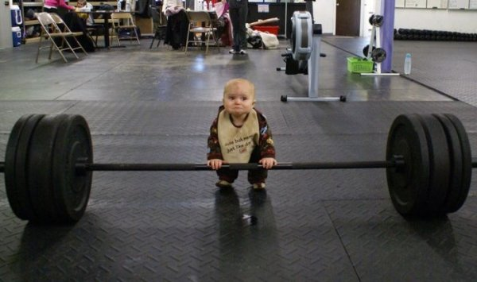
Why??
2. Brain Exercise – children need rhythm in their development

Slide 4
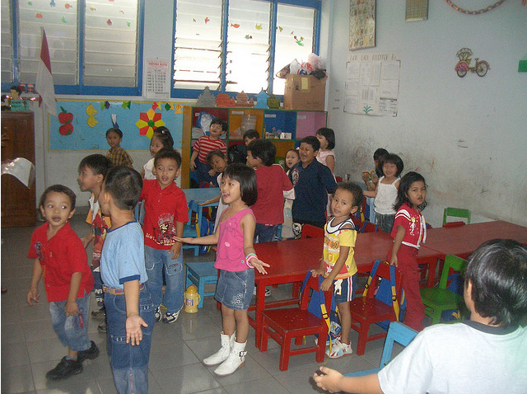
Why??
3. Language – pronunciation, vocabulary and grammar …

Slide 5
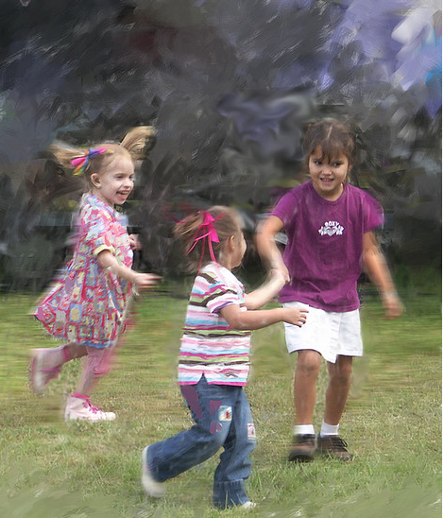
Sometimes you want them to be lively and loud.

Slide 6
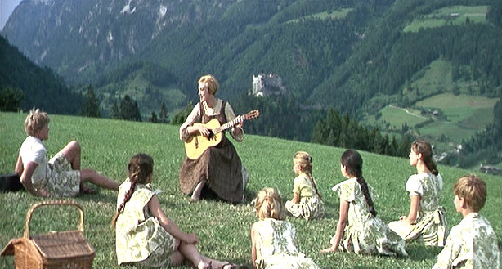
Sometimes you want them to be settled and quiet

Slide 7
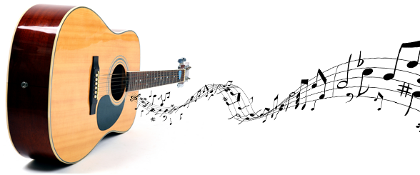
Maybe you could try playing a guitar … (it’s easy!)

Slide 8
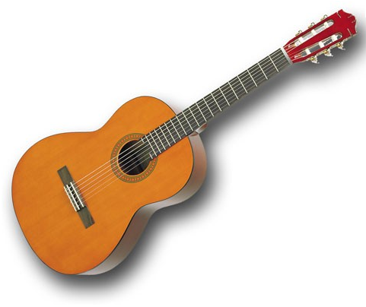

Guitar Chords

Slide 9
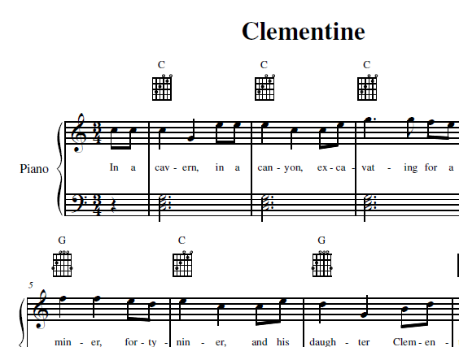
Guitar Music

Slide 10
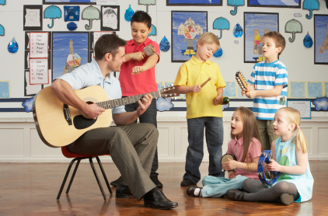
So lets try some songs, and poems …

Slide 11
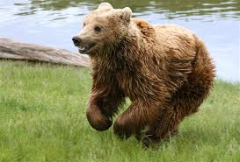
The bear went over the mountain
The bear went over the mountain
The bear went over the mountain
To see what he could see
To see what he could see
And all that he could see
And all that he could see
Was the other side of the mountain
The other side of the mountain
The other side of the mountain
Was all that he could see.

Slide 12
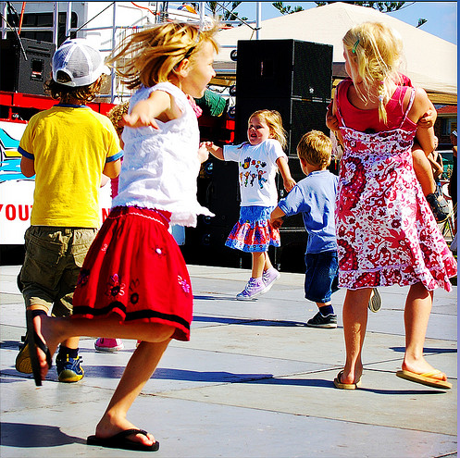
The Hokey Pokey
You put your right foot in,
You put your right foot out,
You put your right foot in
And you shake it all about.
You do the Hokey Pokey
And you turn yourself around,
That's what it's all about.
You put your left foot in,
You put your right hand in,
You put your left hand in,
You put your right shoulder in,
You put your left shoulder in,
You put your right hip in,
You put your left hip in,
You put your whole self in,

Slide 13
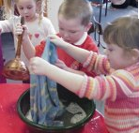
Mulberry Bush
Here we go 'round the mulberry bush,
The mulberry bush, the mulberry bush.
Here we go 'round the mulberry bush,
So early in the morning.
This is the way we wash our clothes,
Wash our clothes, wash our clothes.
This is the way we wash our clothes,
So early Monday morning.
This is the way we iron our clothes…
… So early Tuesday morning.
This is the way we mend our clothes…
…Wednesday morning.
This is the way we sweep the floor …
…Thursday morning.
This is the way we scrub the floor,
… Friday morning.
This is the way we bake our bread,
… Saturday morning.
This is the way we go to church,
… Sunday morning.

Slide 14
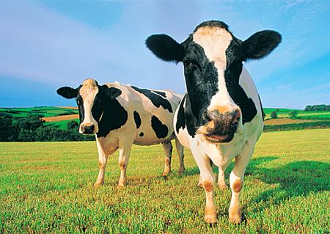
Farmer in the Dell
The farmer in the dell
The farmer in the dell
Hi-ho the dairy-o
The farmer in the dell
The farmer takes a wife
The farmer takes a wife
Hi-ho the dairy-o
The farmer takes a wife
Repeat with:
Wife takes a child
Child takes a dog
Dog takes a cat
Cat takes a rat
Rat take the cheese
Cheese stands alone

Slide 15
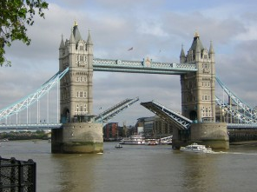
London Bridge
London Bridge is falling down, falling down, falling down,
London Bridge is falling down, my fair lady-o.
Build it up with sticks and stones, sticks and stones, sticks and stones,
Build it up with sticks and stones, my fair lady-o.

Slide 16
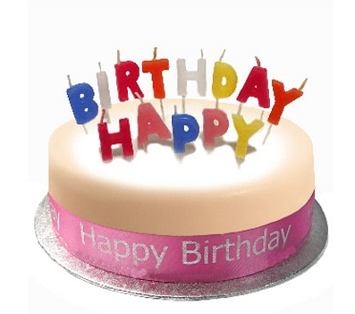
Happy Birthday to you
Happy Birthday to you
Happy Birthday dear ___ ___
Happy Birthday to you.

Slide 17
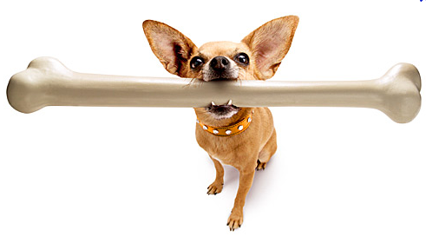
This Old Man
This old man, he played one,
He played knick-knack on my thumb
With a knick-knack paddywack
Give the dog a bone
This old man came rolling home
Other Verses:
Two...shoe
Three...knee
Four...door
Five...hive
Six...sticks
Seven...heaven
Eight...gate
Nine...down the line
Ten...in the den

Slide 18
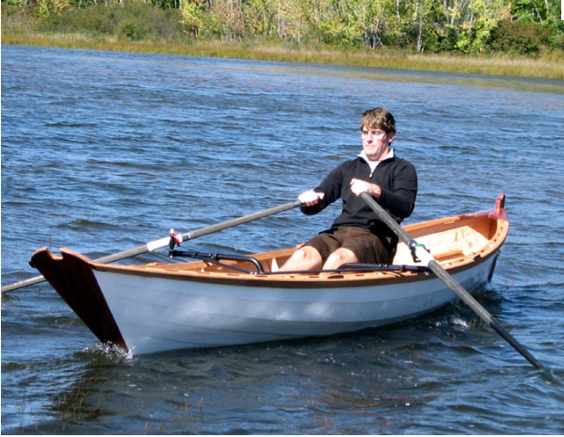
Row, Row, Row Your Boat
Row, row, row your boat
Gently down the stream
Merrily, merrily, merrily, merrily
Life is but a dream

Slide 19
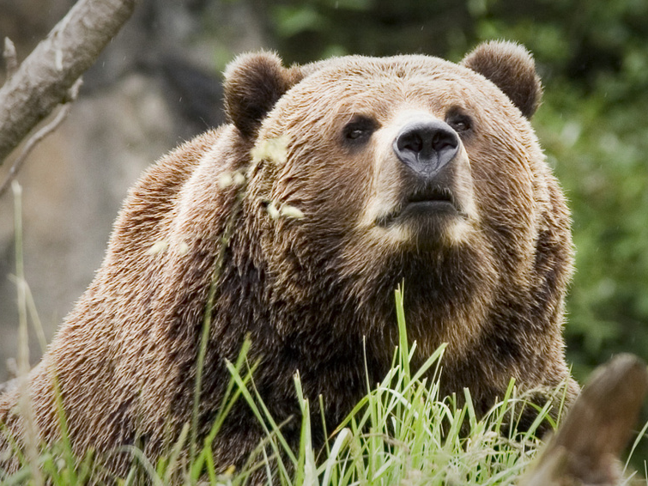
Echo song:
I met a bear

Slide 20
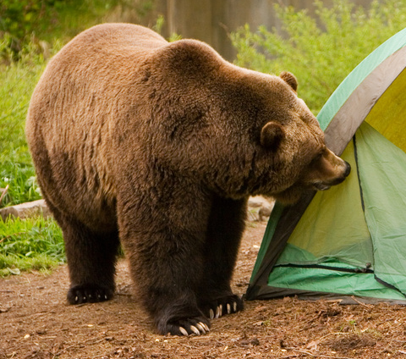
Leader, then echo, then unison ...
Leader: Group, echoing:
The other day (The other day)
I met a bear (I met a bear)
A way up there (A way up there)
A great big bear (A great big bear)
Everyone:
The other day I met a bear
A great big bear a way up there
[Continue this pattern throughout the song.]
He looked at me
I looked at him
He sized up me
I sized up him
He said to me
Why don't you run
I see you don’t
Have any gun

Slide 21
I met a bear (cont ...)
[I said to him
That's a good idea
So come on feet
Let's get out of here]
And so I ran
Away from there
And right behind
Me was that bear
Ahead of me
I saw a tree
A great big tree
Oh, Golly Gee!
The lowest branch
Was ten feet up
I had to jump
And trust my luck
And so I jumped
Into the air
And missed that branch
A way up there
Now don't you fret
And don't you frown
I caught that branch
On the way back down
That's all there is
There is no more
Until I meet
That bear once more
The end, the end, The end, the end
The end, the end, The end, the end
... This time it really is the end.

Slide 22
Another
Version
The littlest worm I ever saw
Got stuck inside My soda straw
He said to me Don't take a sip
For if you do I'll surely slip
I took a sip And he went down
All through my pipes He must have drowned
He was my pal He was my friend
And now he's gone And that's the end
The moral of (Repeat) This little tale (Repeat)
Is If you see a worm (Repeat) Just don't inhale (Repeat)
(Repeat everything shouting:) Just Don't Inhale!

Slide 23
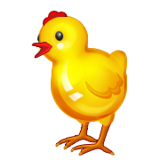
Well-known, easy tune, lots of possibilities for variation ...
Old MacDonald
Old MacDonald had a farm, E I E I O,
And on his farm he had some chicks, E I E I O.
With a chick chick here and a chick chick there,
Here a chick, there a chick, ev'rywhere a chick chick.
Old MacDonald had a farm, E I E I O.
Old MacDonald had a farm, E I E I O,
And on his farm he had a cow, E I E I O.
With a moo moo here and a moo moo there,
Here a moo, there a moo, ev'rywhere a moo moo.
Old MacDonald had a farm, E I E I O.
...

Slide 24
Well-known, easy tune, lots of possibilities for variation ...
Old MacDonald
Create songs for vocabulary practice within a theme:
In the shop they have some ...
drinks / toys / books / ...
In the street I saw a ...
bus / car / truck ...
On my desk I have some ...

Slide 25
Variation – practice adjective opposites etc
Old MacDonald had a farm E-I-E-I-O
And on that farm he had some cows E-I-E-I-O
Fat cow, thin cow, thin cow, fat cow.
Old MacDonald had a farm E-I-E-I-O
Old MacDonald had a farm E-I-E-I-O
And on that farm he had some sheep E-I-E-I-O
Tall sheep, short sheep, short sheep, tall sheep.
Fat cow, thin cow, thin cow, fat cow.
Old MacDonald had a farm E-I-E-I-O
Old MacDonald had a farm E-I-E-I-O
And on that farm he had some ducks E-I-E-I-O
Big ducks, small ducks, small ducks, big ducks,
Tall sheep, short sheep, short sheep, tall sheep,
Fat cow, thin cow, thin cow, fat cow.
Old MacDonald had a farm E-I-E-I-O
And lots more possibilities such as:
...he had some cats
E-I-E-I-O
Sleepy cats, scary cats, scary cats, sleepy cats ...

Slide 26
Two part song, very long, repetitive ...
Boys: There’s a hole in my bucket, dear Liza, dear Liza.
There’s a hole in my bucket, dear Liza, a hole.
Girls: Then fix it, dear Henry, dear Henry, dear Henry.
Then fix it, dear Henry, dear Henry, fix it.
Boys: With what shall I fix it, dear Liza, dear Liza?
With what shall I fix it, dear Liza, dear Liza?
Girls: With a straw, dear Henry, dear Henry, dear Henry.
With a straw, dear Henry, dear Henry, a straw.
  Boys: But the straw is too long, dear Liza, dear Liza, dear Liza.
But the straw is too long, dear Liza, too long.
[This song is in Waltz time]
Continued ...

Slide 27
With a twist ... making it a circular song.
Girls: Then cut it, dear Henry, dear Henry, ...
Boys: With what shall I cut it, dear Liza, ...
Girls: With an axe, dear Henry, ...
Boys: But the axe is too blunt, dear Liza, ...
Girls: Then sharpen it, dear Henry, ...
Boys: With what shall I sharpen it, dear Liza, ...
Girls: With a stone, dear Henry, ...
Boys: But the stone is too dry, dear Liza, ...
Girls: Then wet it, dear Henry, ...
Boys: With what shall I wet it dear Liza,...
Girls: With water, dear Henry, ...
Boys: In what shall I fetch it, dear Liza, ...
Girls: In a bucket, dear Henry, ....
Boys: But there’s a HOLE in my bucket, dear Liza, dear Liza!
There’s a hole in my bucket, dear Liza, dear Liza, a hole!

Slide 28
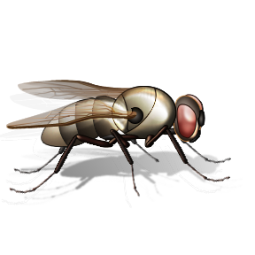

A cumulative song:
I knew an old lady who swallowed a fly
I don't know why she swallowed the fly
Perhaps she'll die
I knew an old lady who swallowed a spider
That wiggled and jiggled and tickled inside her
She swallowed a spider to catch the Fly
I don't know why she swallowed the fly
Perhaps she'll die
...
How absurd, to swallow a bird!
She swallowed a bird to catch the spider ...
[This song is in compound time]
Continued ...

Slide 29
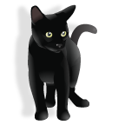
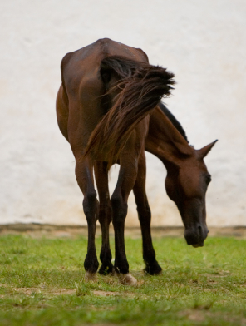
... Imagine that, she swallowed a cat! ...
... What a hog, to swallow a dog! ...
... She opened her throat and swallowed the goat! ...
... I don't know how she swallowed the cow! ...
I knew an old lady who swallowed a horse.
She's dead of course!

Slide 30
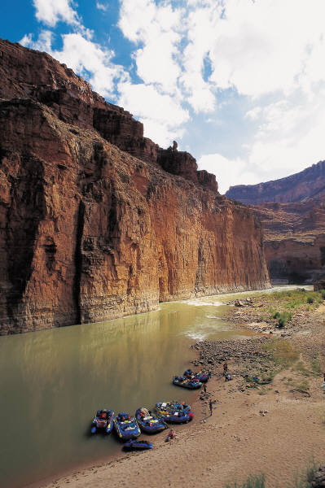
In a cavern, in a canyon
Excavating for a mine
Lived a miner forty-niner
And his daughter, Clementine
Chorus:
Oh, my darling, oh, my darling
Oh, my darling Clementine
You are lost and gone forever
Dreadful sorry, Clementine
Light she was and like a fairy
And her shoes were number nine
Herring boxes without topses
Sandals were for Clementine
(chorus)
Drove her ducklings to the water
Every morning just at nine
Hit her foot against a splinter
Fell into the foaming brine
(chorus)
Clementine
A tune to use for many things
Ruby lips above the water
Blowing bubbles soft and fine
But, alas, I was no swimmer
So I lost my Clementine
(chorus)
How I missed her, how I missed her
How I missed my Clementine
Till I kissed her little sister
And forgot my Clementine
Oh, my darling, oh, my darling
Oh, my darling Clementine
You are lost and gone forever
Dreadful sorry, Clementine
[This song is in waltz time]

Slide 31

Using Clementine for circle time
What‘s the weather
What's the weather
What's the weather like today?
Tell us (name), what's the weather?
What's the weather like today?
Is it sunny (make big circle with arms above head)
Is it cloudy (cover eyes with hands)
Is it rainy out today (rain fingers)
Is it snowy (act cold)
Is it windy (windy arms)
What's the weather like today?

Slide 32
Circular song: - Found a Peanut
Found a peanut, found a peanut,
Found a peanut just now,
Just now I found a peanut,
Found a peanut just now.
Cracked it open, cracked it open, ...
It was rotten, it was rotten, ...
Ate it anyway, ate it anyway, ...
Got a stomach ache, got a stomach ache, ...
Called the doctor, called the doctor, ...
Penicillin, Penicillin, ...
Operation, operation, ...
Died anyway, died anyway, ...
Went to heaven, went to heaven, ...
Wouldn't take me, wouldn't take me, ...
Went the other way, went the other way, ...
Didn't want me, didn't want me, ...
Was a dream, was a dream, ...
Then I woke up, then I woke up, ...
Found a peanut, found a peanut, ...
Tune: Clementine

Slide 33
Another
Circular
Song
There's a spider on the floor, on the floor.
There's a spider on the floor, on the floor.
Who could ask for anything more, than a spider on the floor.
There's a spider on the floor, on the floor.
Now the spider's on my leg, on my leg. ...
Oh, I wish I had some Raid for this spider on my leg! ...
Now the spider's on my chest, on my chest! ...
Oh, I'd squish him in my vest, if it didn't make a mess! ...
Now the spider's on my neck, on my neck! ...
Oh, I'm gonna be a wreck, I've got a spider on my neck! ...
Now the spider's on my face, on my face! ...
Oh, what a big disgrace, I've got a spider on my face! ...
Now the spider's on my head, on my head! ...
Oh, I wish that he were dead. I've got a spider on my head! ...
SPOKEN: "But he jumped off.... “ [start back at the beginning]
Tune: if you’re happy and you know it

Slide 34
Frog went a courtin' and he did ride, uh-huh
Frog went a courtin' and he did ride
With a sword and a pistol by his side, uh-huh uh-huh.
He rode right up to Miss Mousie's door, uh-huh ... (repeat)
Gave three loud raps, and a very big roar, uh-huh uh-huh.
He said, "Miss Mouse, will you marry me? uh-huh ...
And oh so happy we will be, uh-huh uh-huh.
"Not without Uncle Rat's consent", uh-huh ...
"Would I marry the President," uh-huh uh-huh.
Uncle Rat, he went downtown, uh-huh ...
To buy his niece a wedding gown, uh-huh uh-huh.
Where shall the wedding supper be? uh-huh...
Way down yonder in the hollow tree, uh-huh uh-huh.
The first to come in was a bumble bee, uh-huh ...
With a big bass fiddle on his knee, uh-huh uh-huh.
Next to come in was the big black snake, uh-huh ...
He gobbled down the wedding cake, uh-huh uh-huh.
Little bit of biscuit on the shelf, uh-huh ...
If you want anymore you can sing it yourself, uh-huh uh-huh.
Story Song …
[Rock beat music]

Slide 35
A tune for many occasions:
Twinkle Twinkle Little Star
Twinkle, twinkle, little star.
How I wonder what you are!
Up above the world so high
Like a diamond in the sky.
Twinkle, twinkle, little star.
How I wonder what you are!
[March beat]

Slide 36
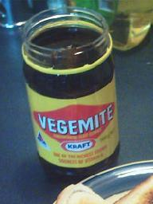
Australian Style
Twinkle
Twinkle, Twinkle Vegemite,
on a sandwich brown or white, Spread it thick on buttered toast.
That's the way I like it most.
Twinkle, Twinkle vegemite,
I'm okay and you're alright

Slide 37
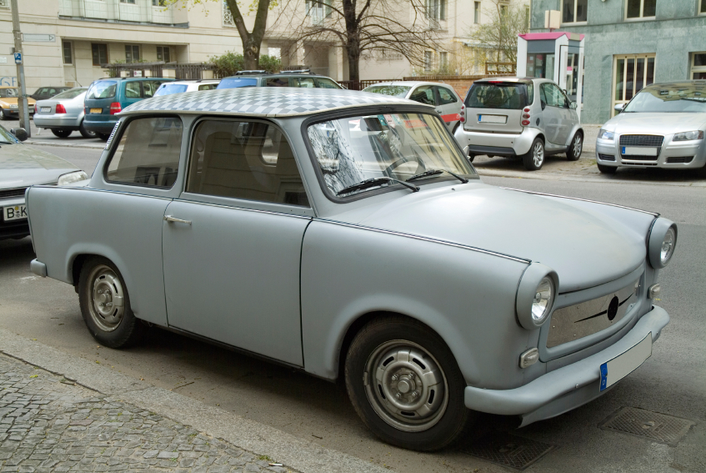
Another Twinkle
Twinkle, Twinkle Little Star
Daddy bought a motor car.
Push the button, pull the choke.
Off We go in a cloud of smoke.
Twinkle, Twinkle Little Star.
Daddy bought a motor car.

Slide 38
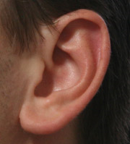
Do Your Ears Hang Low?
Do your ears hang low?
Do they wobble to and fro?
Can you tie them in a knot?
Can you tie them in a bow?
Can you throw them over your shoulder
like a continental soldier?
Do your ears hang low?
Do your ears hang high?
Do they reach up to the sky?
Do they droop when they're wet?
Do they stiffen when they're dry?
Can you semaphore your neighbour
with a minimum of labour?
Do your ears hang high?
Do your ears hang wide?
Do they flap from side to side?
Do they wave in the breeze
From the slightest little sneeze?
Can you soar above the nation
with a feeling of elation?
Do your ears hang wide?
Do your ears fall off?
When you give a great big cough?
Do they lie there on the ground?
Or bounce up at every sound?
Can you stick them in your pocket
just like little Davy Crockett?
Do your ears fall off?

Slide 39
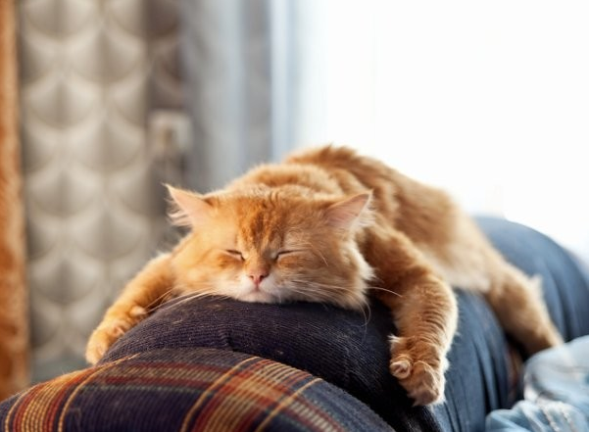
Rheumatism, Rheumatism,
How it pains, How it pains,
Up and down my system,
Up and down my system,
When it rains, When it rains.
Frère Jacques,
Frère Jacques,
Dormez vous?
Dormez vous?
Sonnez les matines,
Sonnez les matines,
Din, din, don!
Din, din, don!
Are you sleeping,
Are you sleeping?
Brother John?
Brother John?
Morning bells are ringing,
Morning bells are ringing,
Ding ding dong,
Ding ding dong.

Slide 40
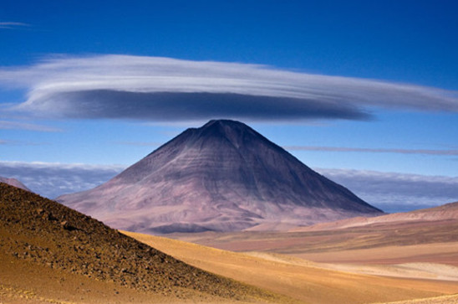
She’ll be Coming Round the Mountain
She'll be comin' 'round the mountain when she comes. (Whoo, whoo!)
She'll be comin' 'round the mountain when she comes. (Whoo, whoo!)
She'll be comin' 'round the mountain, comin' 'round the mountain
She'll be comin' 'round the mountain when she comes. (Whoo, whoo!)
She'll be driving six white horses, when she comes (Whoa, back!)
. . .
She'll be driving six white horses, when she comes
(Whoa, back! Whoo, Whoo!)
Oh, we'll all go out to meet her when she comes (Hi babe!) . . .
She'll be wearing silk pajamas when she comes [Wolf whistle] . . .
And, we'll wear our bright red woolies when she comes [Scratch, scratch!] . . .
More verses ...
[Rock beat]

Slide 41
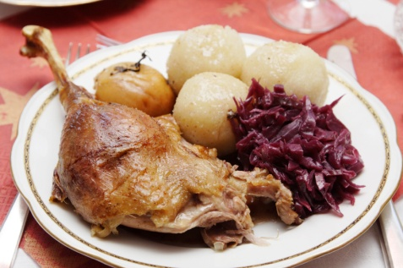
Oh, we'll kill the old red rooster,
when she comes (chop chop)
Oh, we'll all have chicken and dumplings when she comes
(Yum, yum! / Yuck, yuck!) . . .
Oh, we'll all have indigestion when she comes
(Burp, burp!) . . .
Oh, she'll have to sleep with Grandma when she comes (Snore, snore!) . . .
She'll have to sleep with Grandma when she comes (snore snore, burp burp, yum yum, hack hack, scratch scratch, [wolf whistle], Hi babe!, Whoa! Back!, Whoo Whoo!)

